Slide 1
How Can You Choose
THE BEST
Delivery Method?

Slide 2
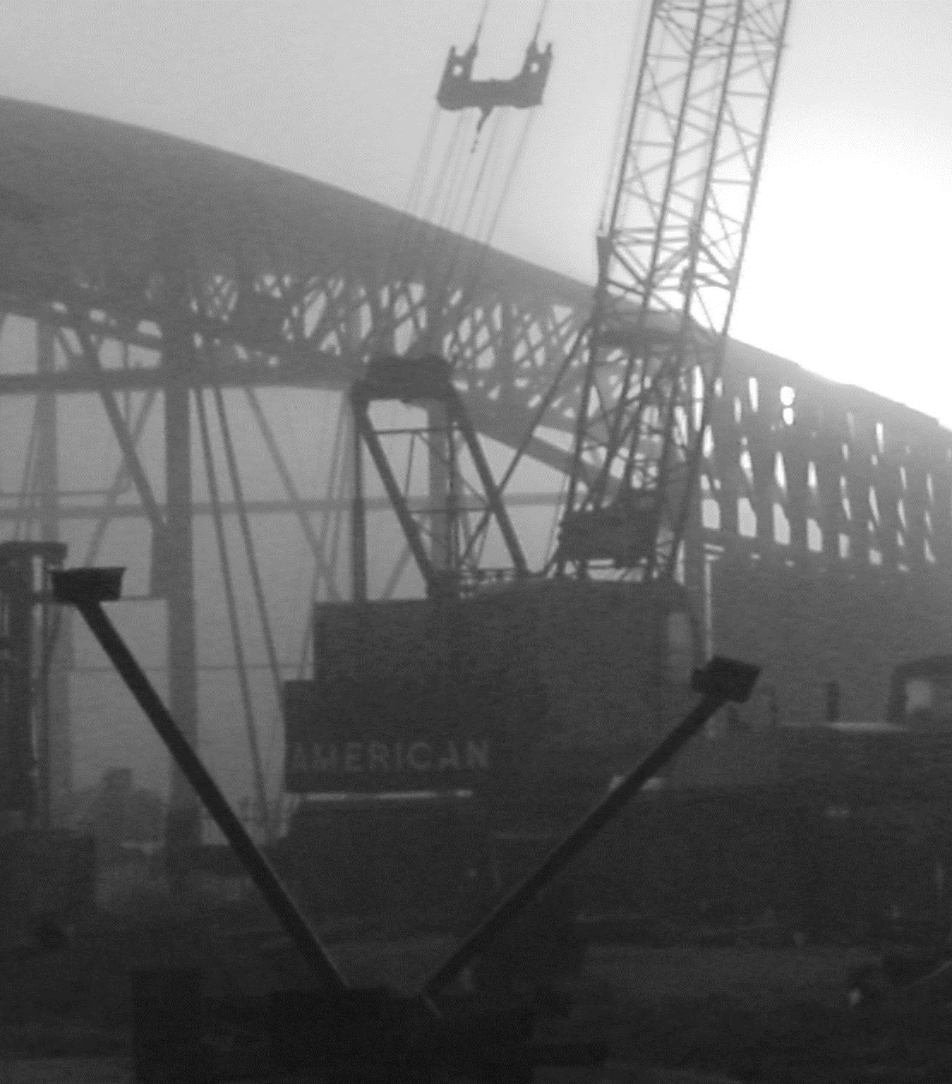
The Path to Success

Slide 3
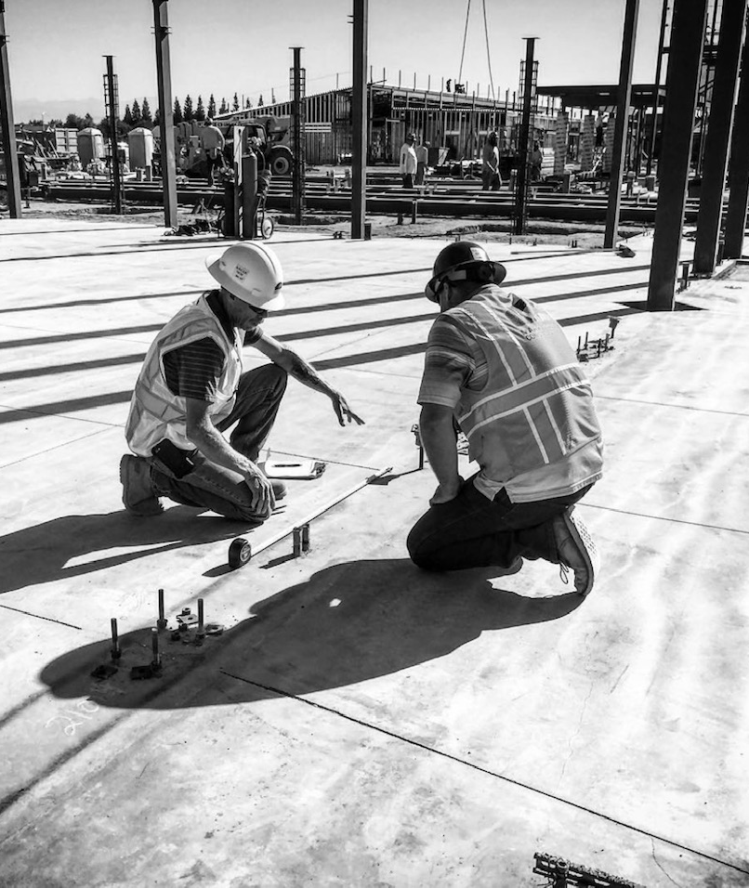
“It is Simple… But Not Easy”
Jocko Willink

Slide 4
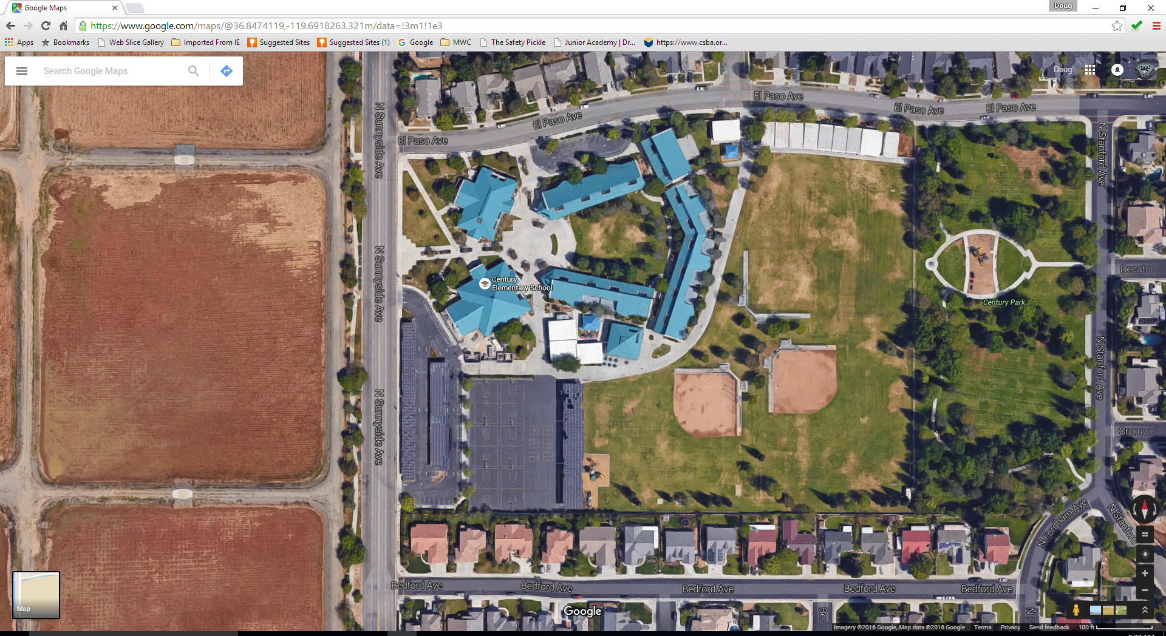
Time of day or night
Staff, Student, and Community Safety
Metal Roofing
Water, Sewer Strom Drain
Phasing
Amount to be put in place per schedule
Potential for change order
End of School
Summer break
Testing
Facility protection
Safety
Initial and Final Cost
Structural damage
Door frames
Path of travel
Bid Period
District Staff Expertise
Existing Campus Impact
Breaks – Summer, winter, Spring
Budget for project
Student relocation
Fencing
District Staff Availability
Preconstruction
Noise
Meetings
Rebid Requirements
Start of school
Project Complexity
Educational Impact
Daily classes
Quality
Campus Security
Distractions
Dollar Amount
Number of Trades
In house hiring
Conflict resolution
Exposure to extra work
Coordination
Material Lead Times
Time of year
Value Engineering
Time for trades to review
Market
Finishes
Use of areas
Utility Interruptions
Utilities
Alternates
Steel and deck
Scope and drawing review
Skylights
Project Size
Duration
Contractor capacity
Construction Operation
Unforeseen Work
Utility damages
Material Availability
Cost
Outside consultant
Power
Electrical equipment
Fire Sprinklers
HVAC Equipment
Time constraints for school function
Granularity of bid results and information
Glass and Window systems
Time
Access
Funds available
Low Voltage Systems – Data, Fire Alarm, Clock , PA

Slide 5
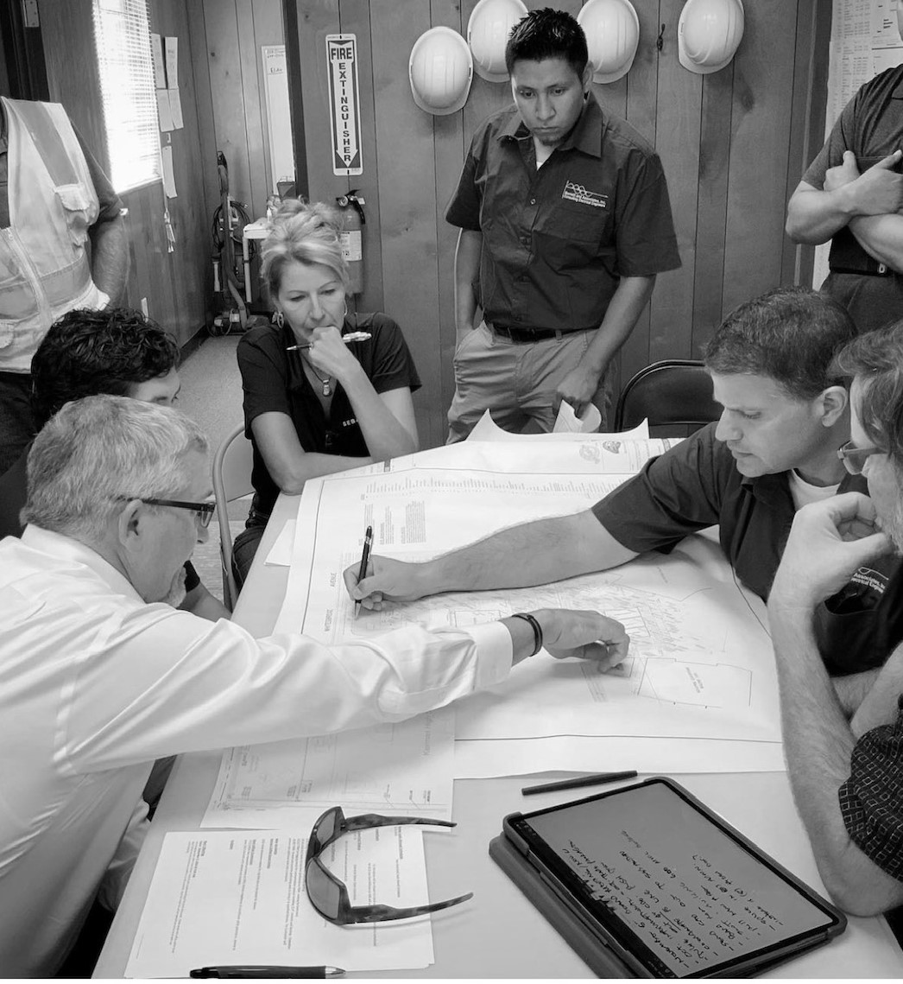
“You cannot predict… But you can prepare”
Jim Collins

Slide 6
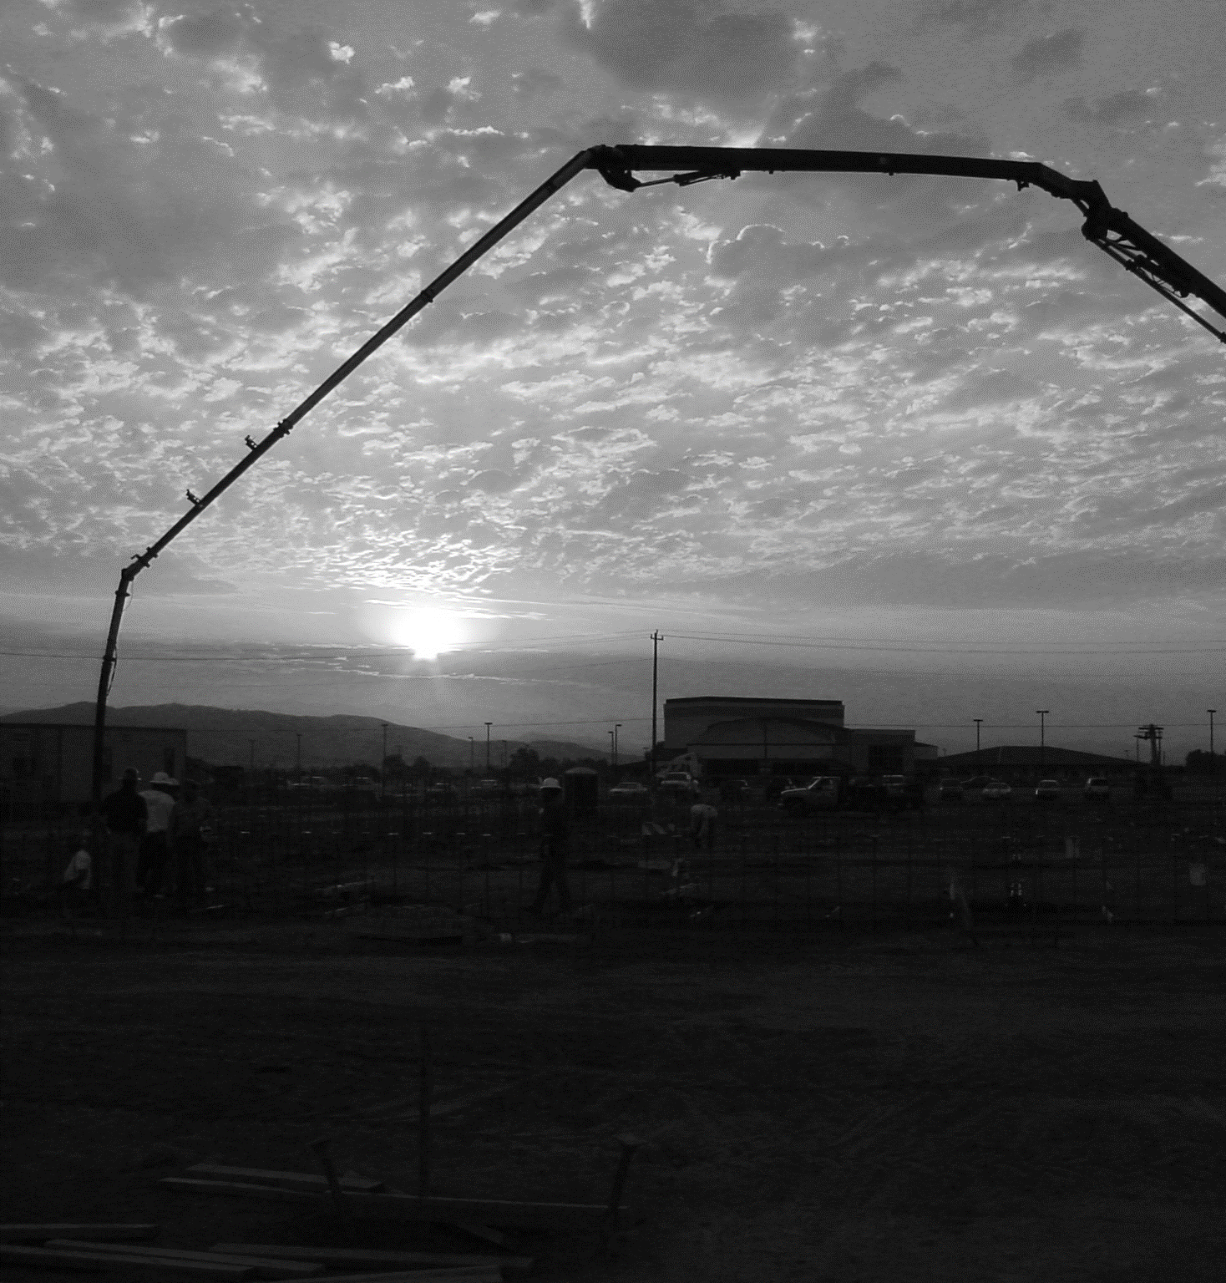
Principles
Use a Discovery Mind Set
Discipline and Diligence
Set Expectations

Slide 7
Time of day or night
Staff, Student, and Community Safety
Metal Roofing
Water, Sewer Strom Drain
Phasing
Amount to be put in place per schedule
Potential for change order
End of School
Summer break
Testing
Facility protection
Safety
Initial and Final Cost
Structural damage
Door frames
Path of travel
Bid Period
District Staff Expertise
Existing Campus Impact
Breaks – Summer, winter, Spring
Budget for project
Student relocation
Fencing
District Staff Availability
Preconstruction
Noise
Meetings
Rebid Requirements
Start of school
Project Complexity
Educational Impact
Daily classes
Quality
Campus Security
Distractions
Dollar Amount
Number of Trades
In house hiring
Conflict resolution
Exposure to extra work
Coordination
Material Lead Times
Time of year
Value Engineering
Time for trades to review
Market
Finishes
Use of areas
Utility Interruptions
Utilities
Alternates
Steel and deck
Scope and drawing review
Skylights
Project Size
Duration
Contractor capacity
Construction Operation
Unforeseen Work
Utility damages
Material Availability
Cost
Outside consultant
Power
Electrical equipment
Fire Sprinklers
HVAC Equipment
Time constraints for school function
Granularity of bid results and information
Glass and Window systems
Time
Access
Funds available
Low Voltage Systems – Data, Fire Alarm, Clock , PA

Slide 8
Time of day or night
Staff, Student, and Community Safety
Metal Roofing
Water, Sewer Strom Drain
Phasing
Amount to be put in place per schedule
Potential for change order
End of School
Summer break
Testing
Facility protection
Safety
Initial and Final Cost
Structural damage
Door frames
Path of travel
Bid Period
District Staff Expertise
Existing Campus Impact
Breaks – Summer, winter, Spring
Budget for project
Student relocation
Fencing
District Staff Availability
Preconstruction
Noise
Meetings
Rebid Requirements
Start of school
Project Complexity
Educational Impact
Daily classes
Quality
Campus Security
Distractions
Dollar Amount
Number of Trades
In house hiring
Conflict resolution
Exposure to extra work
Coordination
Material Lead Times
Time of year
Value Engineering
Time for trades to review
Market
Finishes
Use of areas
Utility Interruptions
Utilities
Alternates
Steel and deck
Scope and drawing review
Skylights
Project Size
Duration
Contractor capacity
Construction Operation
Unforeseen Work
Utility damages
Material Availability
Cost
Outside consultant
Power
Electrical equipment
Fire Sprinklers
HVAC Equipment
Time constraints for school function
Granularity of bid results and information
Glass and Window systems
Time
Access
Funds available
Low Voltage Systems – Data, Fire Alarm, Clock , PA

Slide 9
Staff, Student, and Community Safety
Water, Sewer Strom Drain
Existing Campus Impact
Access
Unforeseen Work
Utilities
Power
Distractions
Utility damages
Finishes
Utility Interruptions
Noise
Path of travel
Safety
Educational Impact
Construction Operation
Quality
Structural damage
Low Voltage Systems – Data, Fire Alarm, Clock , PA
Testing
Project Complexity
Fire Sprinklers
Fencing
Initial and Final Cost
Daily classes
Time of day or night
Facility protection
Start of school
Campus Security
Metal Roofing
Preconstruction
Granularity of bid results and information
Number of Trades
Project Size
Time constraints for school function
Scope and drawing review
Rebid Requirements
Material Lead Times
Exposure to extra work
Door frames
Meetings
Duration
Conflict resolution
Market
Time for trades to review
Use of areas
Alternates
Value Engineering
Coordination
Phasing
Bid Period
Material Availability
Steel and deck
Electrical equipment
District Staff Expertise
Breaks – Summer, winter, Spring
Cost
Outside consultant
Time of year
Time
Skylights
Potential for change order
Contractor capacity
Student relocation
In house hiring
End of School
HVAC Equipment
Dollar Amount
Glass and Window systems
Budget for project
Funds available
Summer break
District Staff Availability
Amount to be put in place per schedule

Slide 10
Safety
Quality
Access
Water, Sewer Strom Drain
Unforeseen Work
Number of Trades
Power
Distractions
Utility Interruptions
Path of travel
Utility damages
Utilities
Finishes
Noise
Educational Impact
Existing Campus Impact
Staff, Student, and Community Safety
Low Voltage Systems – Data, Fire Alarm, Clock , PA
Testing
Project Complexity
Fire Sprinklers
Fencing
Structural damage
Project Size
Campus Security
Construction Operation
Daily classes
Facility protection
Time
Exposure to extra work
Start of school
Cost
Metal Roofing
Preconstruction
Market
Time constraints for school function
Initial and Final Cost
Rebid Requirements
Duration
Scope and drawing review
District Staff Expertise
Door frames
Meetings
Time for trades to review
Alternates
Coordination
Conflict resolution
Value Engineering
Material Availability
Phasing
Bid Period
Use of areas
Outside consultant
Electrical equipment
Time of year
Breaks – Summer, winter, Spring
Skylights
Granularity of bid results and information
Student relocation
Steel and deck
HVAC Equipment
Potential for change order
Contractor capacity
End of School
In house hiring
Glass and Window systems
Budget for project
Dollar Amount
Summer break
Material Lead Times
Amount to be put in place per schedule
Funds available
Time of day or night
District Staff Availability

Slide 11
Safety
Quality
Distractions
Path of travel
Utility damages
Number of Trades
Access
Daily classes
Educational Impact
Utilities
Finishes
Staff, Student, and Community Safety
Utility Interruptions
Existing Campus Impact
Project Complexity
Structural damage
Water, Sewer Strom Drain
Fire Sprinklers
Fencing
Unforeseen Work
Project Size
Low Voltage Systems – Data, Fire Alarm, Clock , PA
Campus Security
Construction Operation
Testing
Noise
Power
Facility protection
Exposure to extra work
Time
Cost
Start of school
Metal Roofing
Preconstruction
Initial and Final Cost
Market
Rebid Requirements
Time constraints for school function
Door frames
District Staff Expertise
Time for trades to review
Duration
Scope and drawing review
Conflict resolution
Alternates
Value Engineering
Dollar Amount
Coordination
Meetings
Phasing
Material Availability
Outside consultant
Bid Period
Use of areas
Electrical equipment
HVAC Equipment
Granularity of bid results and information
Time of year
Breaks – Summer, winter, Spring
Steel and deck
Skylights
Potential for change order
Contractor capacity
Student relocation
Material Lead Times
End of School
In house hiring
Funds available
Budget for project
Glass and Window systems
Summer break
Amount to be put in place per schedule
Time of day or night
District Staff Availability

Slide 12
Safety
Staff, Client, & Community Safety
Facility Security
Utility Interruptions
Code requirements
Quality
Facility Operational Impact
Project Complexity
Unforeseen Work
Trades available
Cost
District Staff Expertise
Budget Amount
Initial and Final Cost
Market
Time
Phasing
Staff Availability
Material Lead Times
Project Duration

Slide 13
Who has a “Go To” delivery method?

Slide 14
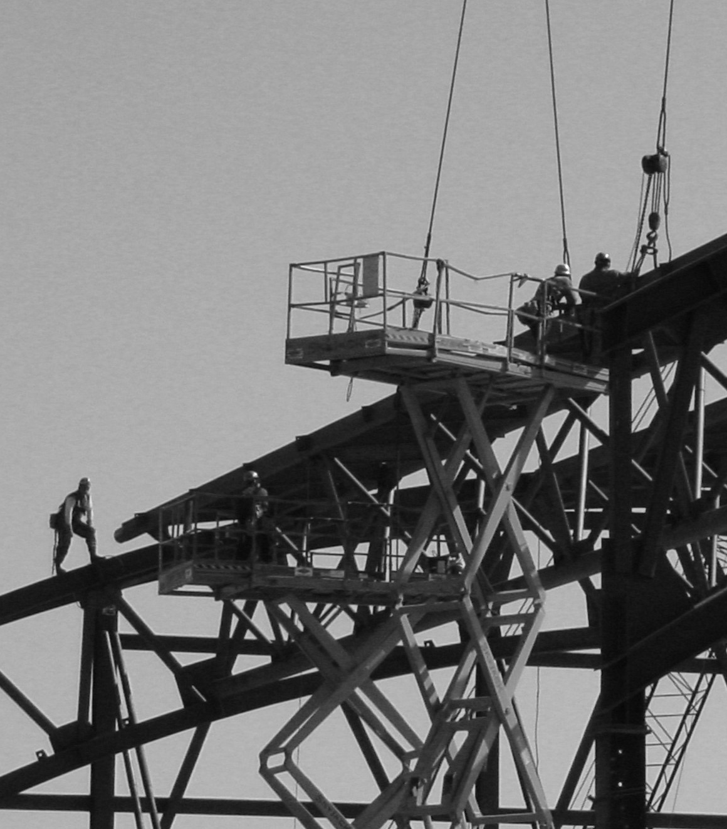
The Challenge for today?

Slide 15
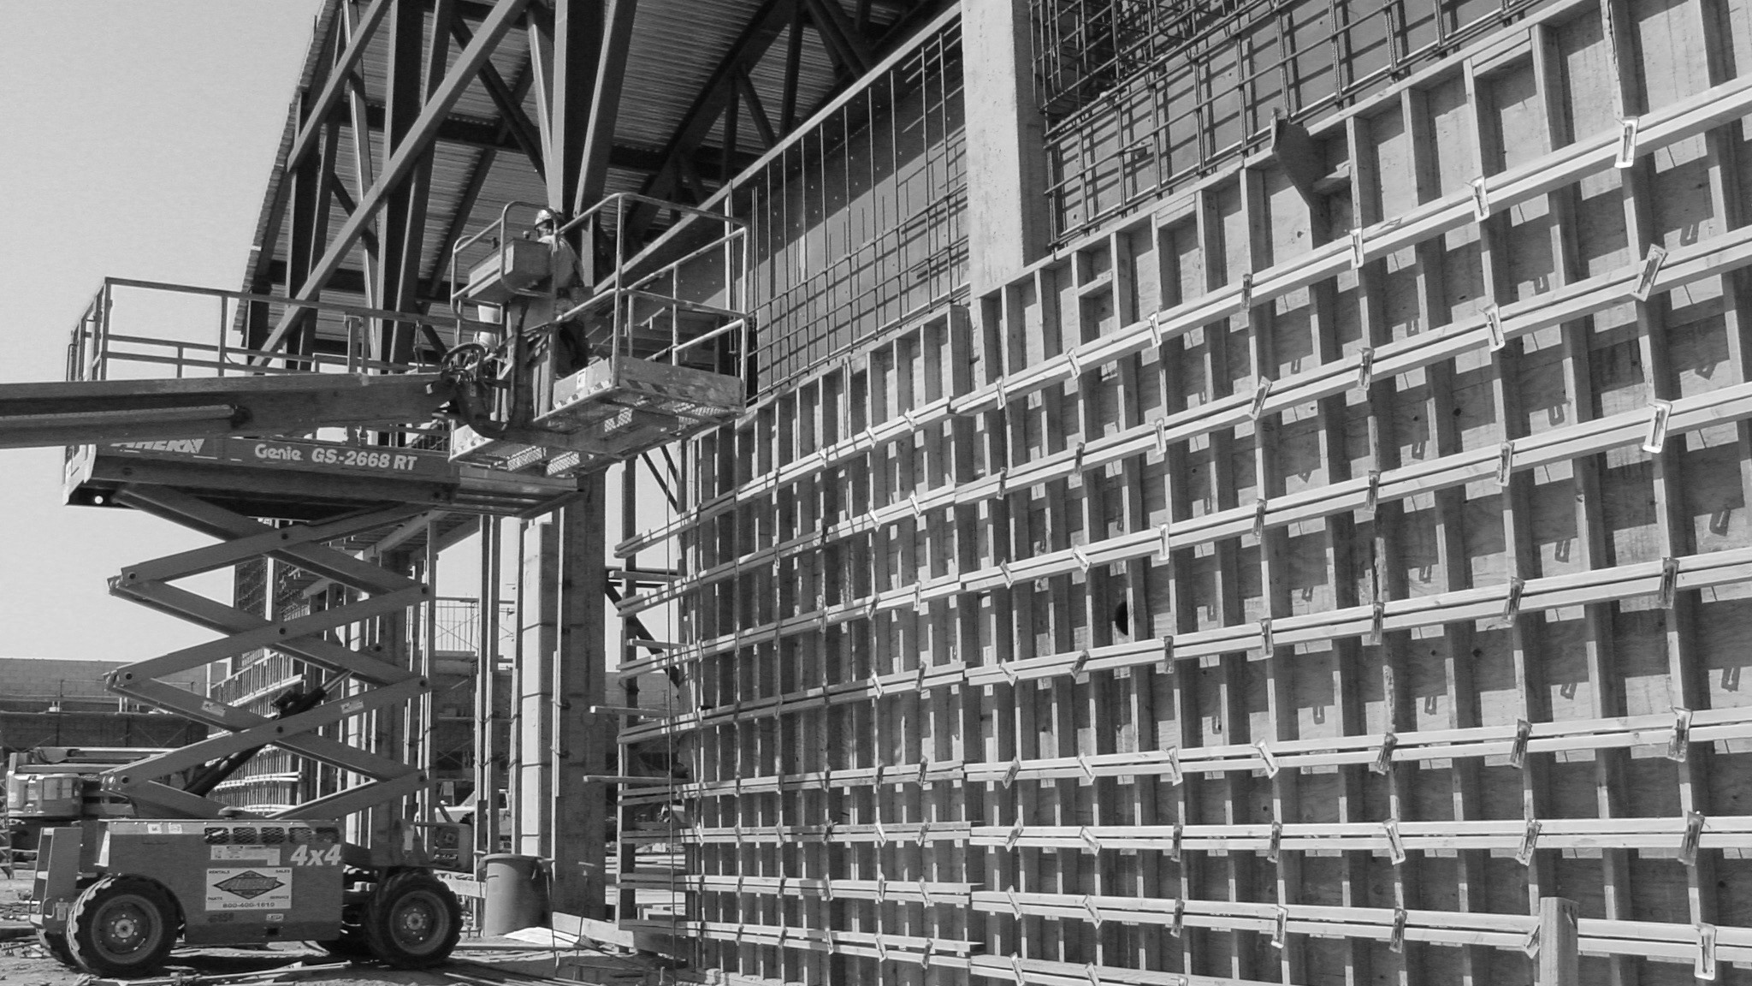
Sample Projects

Slide 16
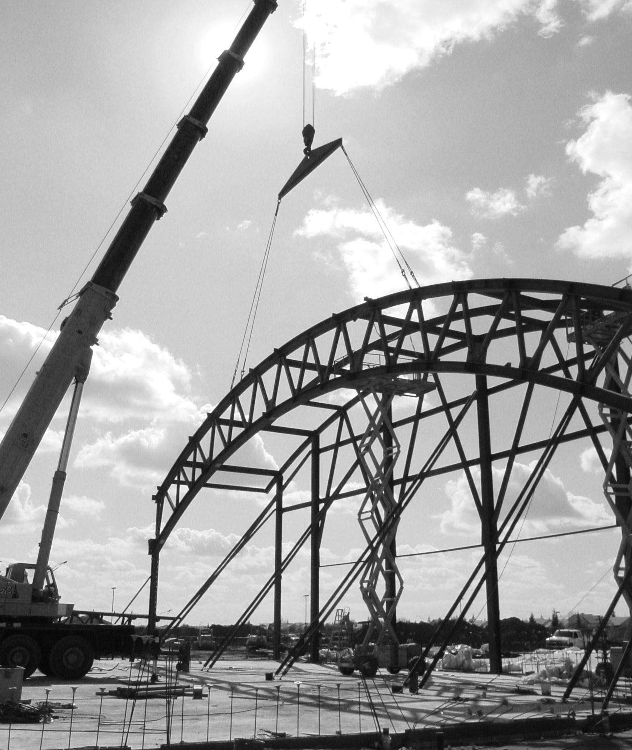
Prioritizing

Slide 17
Report

Slide 18
Questions

Slide 19
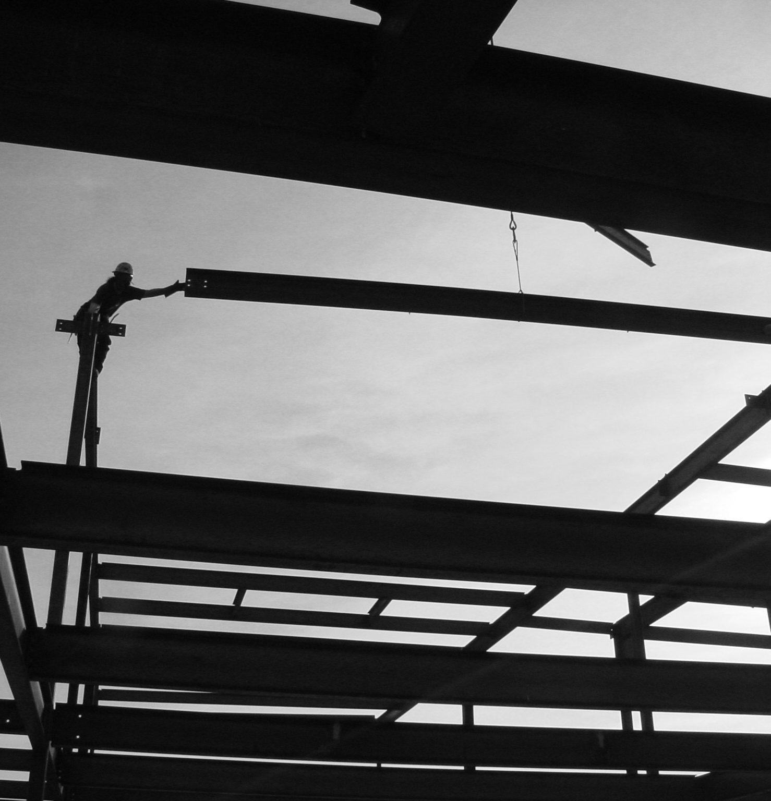
Principles to Remember
Delivery Methods are Tools Not Solutions
Use a Discovery Mind Set – Desire to learn about the project
Discipline & Diligence – Dig and Solve the Unique Problem
Set Realistic Expectations – There will always be challenges

Slide 20
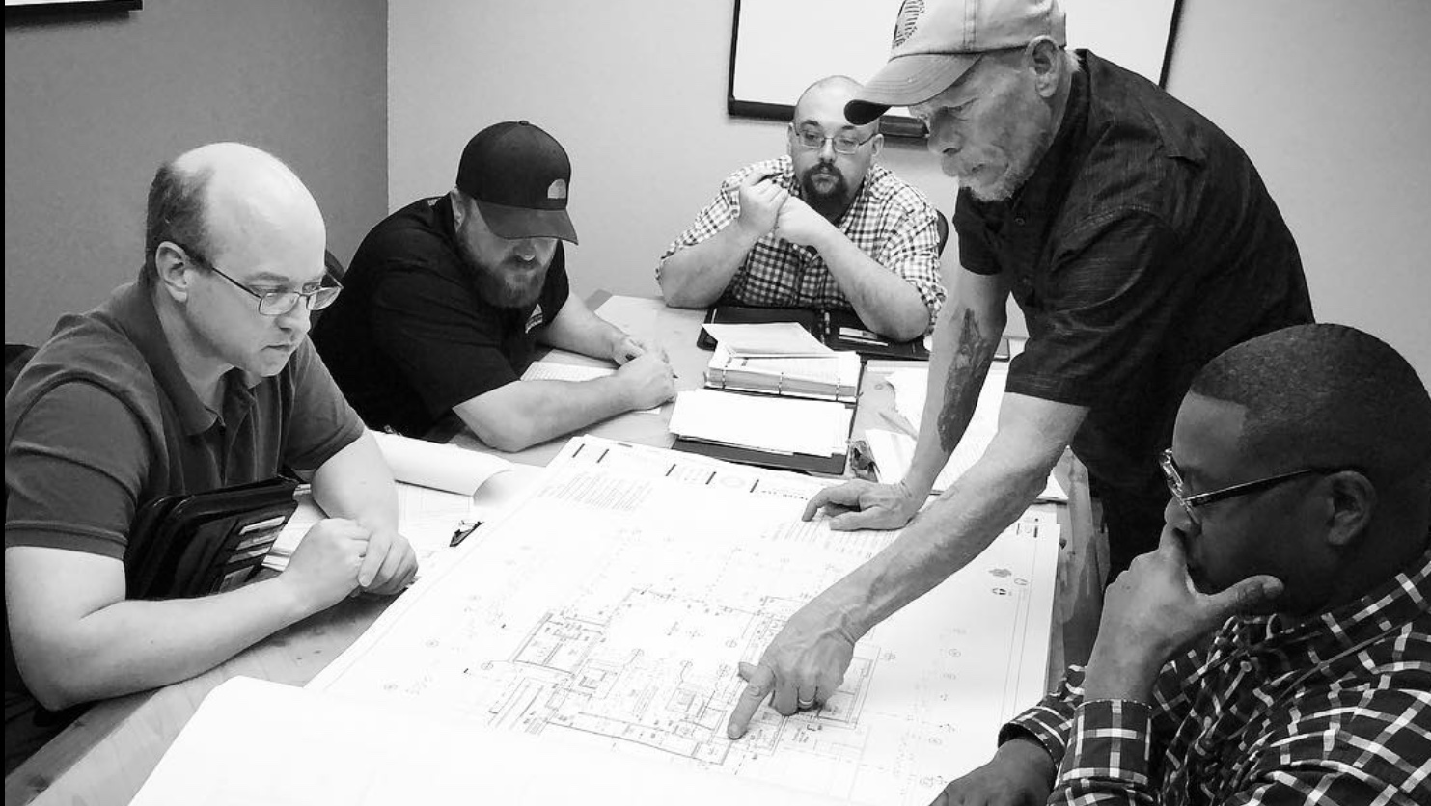
Challenge Yourself
Accept that there is never a “perfect” answer. Be prepared to adapt
Believe that the facts lead you to discover the BEST answer
Use Safety, Quality, Time, & Cost to prioritize

Slide 21
What one thing will you change starting next week?

